Slide 1
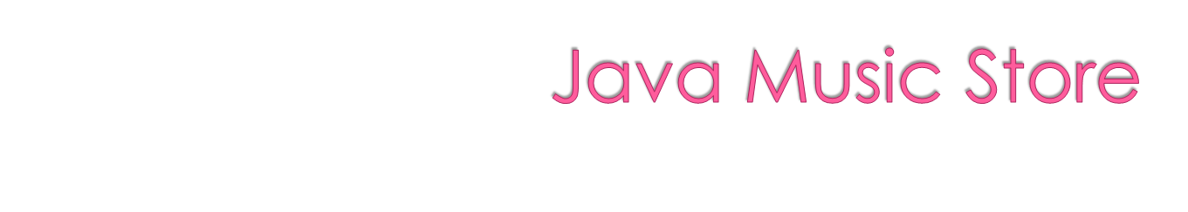
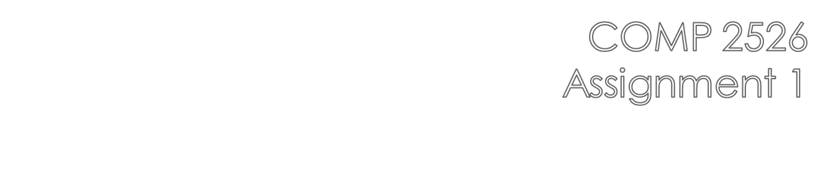

Slide 2

You will be building the data model for renting and purchasing items from a music store
  Customers will be able to purchase or rent musical instruments
This first assignment will form the basis for future assignments
For now, we will be implementing the core functionality of the program in a non-GUI version.

Slide 3

The application will consist of several classes with each assigned a specific purpose.
Function | Classes
Driver | AssignmentDriver
Data | Customer, MusicalInstrument
Data Model | RentalAgreement, ShoppingCart
User Interface | output will be to the console
Utility | DateUtil, ItemSorter(not used this time)

Slide 4

Program driver - provided
All automated functions are initiated here
  Study the class provided to see how the program runs.
  DO NOT change this class in any way

Slide 5

data class
Fields:
  private String firstName;
  private String lastName;
  private String creditCardNumber;
  private String address;
  private String phoneNumber;
Appropriate constructors, getters/setters, and toString()
Default constructor will read input from the console using InputReader utlity class (provided)

Slide 6
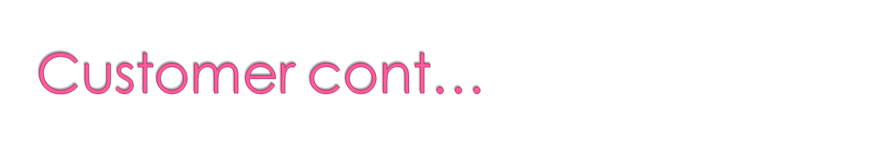
The class provides both accessor and mutator methods for each field, and also a method that returns the full name. The first letter of each name component must be returned from the accessor methods as uppercase and the rest of the letters must be lowercase, no matter how the names are passed to the constructor.
The mutator methods must ensure that names and address fields are not null and are at least one character in length, otherwise the fields will not be “mutated”.

Slide 7

data class
  private String description;
  private String stockCode;
  private int quantityInStock;
  private int quantitySold;
  private double purchasePrice;
  private double sellingPrice;
  private int numberRented;
Appropriate constructors, getters/setters, and toString()

Slide 8

Create a constructor that has parameters for description, stock code, purchase price and selling price. Do NOT provide a constructor argument for the numberRented property. The constructor must check both “price” parameters to be sure they are greater than one. If one of them is, set the relevant field to one. Also, ensure the selling price is at least 10% higher than the purchase price. The other numeric fields must be initialized to zero by default.
For each field in the class, provide both accessor method that returns the value of the field.
Provide a method called restock(). This mutator method takes a parameter that specifies the number of instruments to add to inventory, and adds that number to the quantity in stock. If the parameter is less than one it will display an error message and not change the quantity in stock.

Slide 9
Provide a method called sell(). This mutator method subtracts the parameter value from the quantity in stock, but only if the parameter is not negative. Quantity in stock must never be a negative number. If the parameter is negative or too high, an error message will be displayed and the quantity in stock will not change. The sell() method will also change the quantity sold field by the appropriate amount.
Provide a method called setPurchasePrice(). This mutator method accepts the new purchase price as its parameter and changes the appropriate instance variable, but only if the parameter is not below one.
Provide a method called setSellingPrice(). This mutator method accepts the new selling price as its parameter and changes the appropriate instance variable, but only if the parameter is not below purchasePrice + 10%.

Slide 10
Add a method called setNumberRented() that sets the number of instruments currently rented out. This method should restrict the number of instruments rented to be no more than half the current inventory.
Add a method called calcProfit() that calculates and returns the profit from selling one instrument, based on the purchase price and selling price. This method will not display anything on the screen. Comment the calculation.
Add a method called calcTotalProfit() that calculates and returns the profit from all the instruments that have been sold. This method must invoke calcProfit().
Add a method called calcInventoryValue() that calculates and returns the current value of the quantity in stock, based on purchase price.

Slide 11
Provide a method called printDetails(). This method displays item information on the screen, e.g.
Description: electric guitar
  Stock code: GUI 101
  Purchase price: $250.00
  Selling price: $395.95
  Quantity in stock: 10
  Quantity sold: 12
  Inventory value: $2500.00
  Profit on sales: $1751.40
  Number of instruments rented: 2

Slide 12

data class
  private RentalCustomer customer
  private RentalDate rentalDate
  private MusicalInstrument instrumentRented
  private double rentalFeePerDay
  private int numberOfDaysRented
  private double totalRentalFee
public RentalAgreement(Customer customer, GregorianCalendar rentalDate, MusicalInstrument instrumentRented)
Provide accessor methods for each field in the class. Note that the accessors for customer, rentalDate and instrumentRented will return the relevant objects. There should be NO mutator methods for customer, rentalDate or instrumentRented.

Slide 13

Provide a mutator method for rentalFeePerDay, which checks to ensure the rental fee is greater than $0.00.
Provide a mutator method for numberOfDaysRented, which checks to ensure the number of days is greater than 0 and less than 32.
Provide a mutator method for totalRentalFee, which returns the product of rentalFeePerDay * numberOfDaysRented. This method could be called at the same time you are outputting data to the console. Don’t forget to initialize the totalRentalFee data field.
Provide a method that displays on the screen all the information for a rental agreement, e.g.
  Customer: Harry Hornblower
  Rental date: 2011-06-30
  Instrument rented: french horn
  Fee per day: $20.00
  Number of days rented: 20
  Total rental fee: $400.00

Slide 14
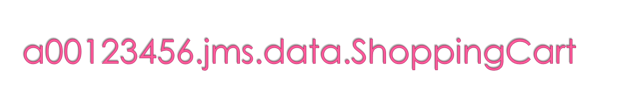
data class
  private ArrayList<MusicalInstrument> purchasedInstruments;
  private ArrayList<RentalAgreement> rentalAgreements;
Implements appropriate constructor, accessor and mutator methods
Implement addToPurchaseCart(MusicalInstrument instrument, int quantity), which will first check to see that the number of Instruments purchased does not exceed the number currently in stock. If the number being purchased is OK, then add that number of Instruments to the purchasedInstruments ArrayList. Also, don’t forget to delete the same number of Instruments from the inventory.

Slide 15
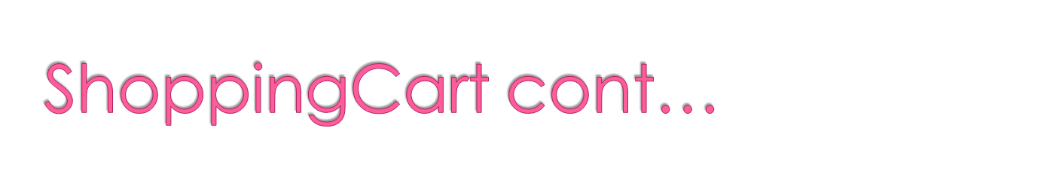
Implement addToRentalCart(RentalAgreement agreement), which is used to add one RentalAgreement at a time to the rentalAgreements ArrayList.
Implement void viewShoppingCarts(), which will display the contents of the purchasedInstruments ArrayList along with the price of each Instrument and a total price for them all. The method will also display the items being rented and the total rental fee for all those rented items.

Slide 16
output from viewShoppingCarts():
  You are purchasing the following items:
  Kazzoo $2.00
  Kazzoo $2.00
  Kazzoo $2.00
  Kazzoo $2.00
  Kazzoo $2.00
  TOTAL: $10.00
  You are renting the following items:
  Kazzoo
  Rental fees due: $31.00

Slide 17

DateUtil – provided
  Same one we’ve been using
InputReader – provided
  used in the Customer() constructor to read comand line data used to create a Customer Object
ItemSorter
  will implement static inner classes to sort MusicalInstruments:
    SortByDescription
    SortByPrice

Slide 18

Week 7 – the week after the midterm
July 3, 2012 – 12:00 p.m. (noon)

Slide 19
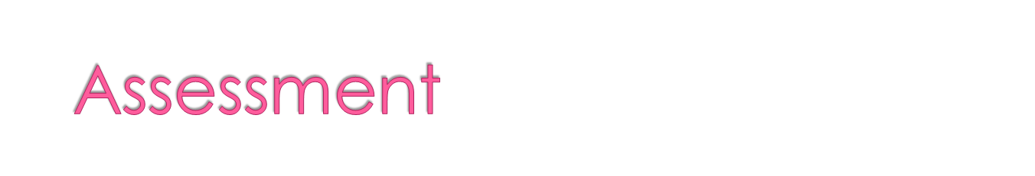
The assignment is worth 10 marks
Your code must compile and run without Exceptions!

